Slide 1

CogniSync Solutions

Slide 2

What are the emissions from today's flight from Stavanger to Rhodos?

Slide 3
OUR INTERPRETATION
GET
FLIGHTS FROM RHODOS TO STAVANGER
GET
EMISSIONS FROM PLANE MODELS
APPLY
EMISSIONS ON PLANES FROM RHODOS TO STAVANGER

Slide 4
UNFORSEEN PROBLEMS
NO ACCESS TO CLIMATIC
NO SCHEDULED FLIGHTS BETWEEN STAVANGER AND RHODOS

Slide 5
GOAL RE-FOCUS
GET
GET DISTANCE BETWEEN RHODOS AND STAVANGER
GET
GET EMISSION FOR PLANE MODEL
APPLY
APPLY EMISSION FOR PLANE MODEL ON DISTANCE

Slide 6
WHAT WE USED
PLANE DATA FROM AVINOR API’S
DISTANCE MATRIX API FROM GOOGLE
GENERIC EMISSION FORMULA FOR BOEING PLANE TYPE

Slide 7
PRE PLANNING PHASE
DISCUSSED WHAT DATA WE HAD AVAILABLE
DISCUSSED WHAT DATA WE NEED

Slide 8
RESEARCH PERIOD
SOLUTIONS
WORKAROUNDS

Slide 9

GITHUB & SECURITY
API KEYS
DB INFO
LOADS VIA FUNCTIONS

Slide 10
DISTRIBUTING TASKS
EXTRACT
INGEBORG, HENRIK
LOAD
MARIUS
TRANSFORM
IN AS CSV
OUT AS JSON

Slide 11
EXTRACT
AVINOR API
1
MAKE A SLICE OF ONLY RELEVANT DATA
EXTRACTING ALL DATA IS TOO MUCH
DISTANCE MATRIX API
2
EXTRACT ALL DATA
NOT MUCH DATA
EXTRACT ALL TO BRONZE
3
AS CSV FILE

Slide 12
TRANSFORM
AVINOR
REMOVES A LIST OF AIRLINES YOU WANT TO REMOVE
IN OUR CASE IT ONLY REMOVES «JUL»
DISTANCE MATRIX
RESTRUCTURE HORRIBLE CSV FORMAT TO DF
GET PLANE DATA
ADD PLANE DATA TO DESTINATION DATA
SAVE TO JSON USING PANDAS

Slide 13
LOAD
READS ALL JSON FILES IN A FOLDER
GENERATES SQL QUERY
CREATES CORRECT DATA TYPE
SETS CORRECT SIZE FOR EACH DATA TYPE
WORKS ON ANY JSON FILE THAT PANDAS LIKES

Slide 14
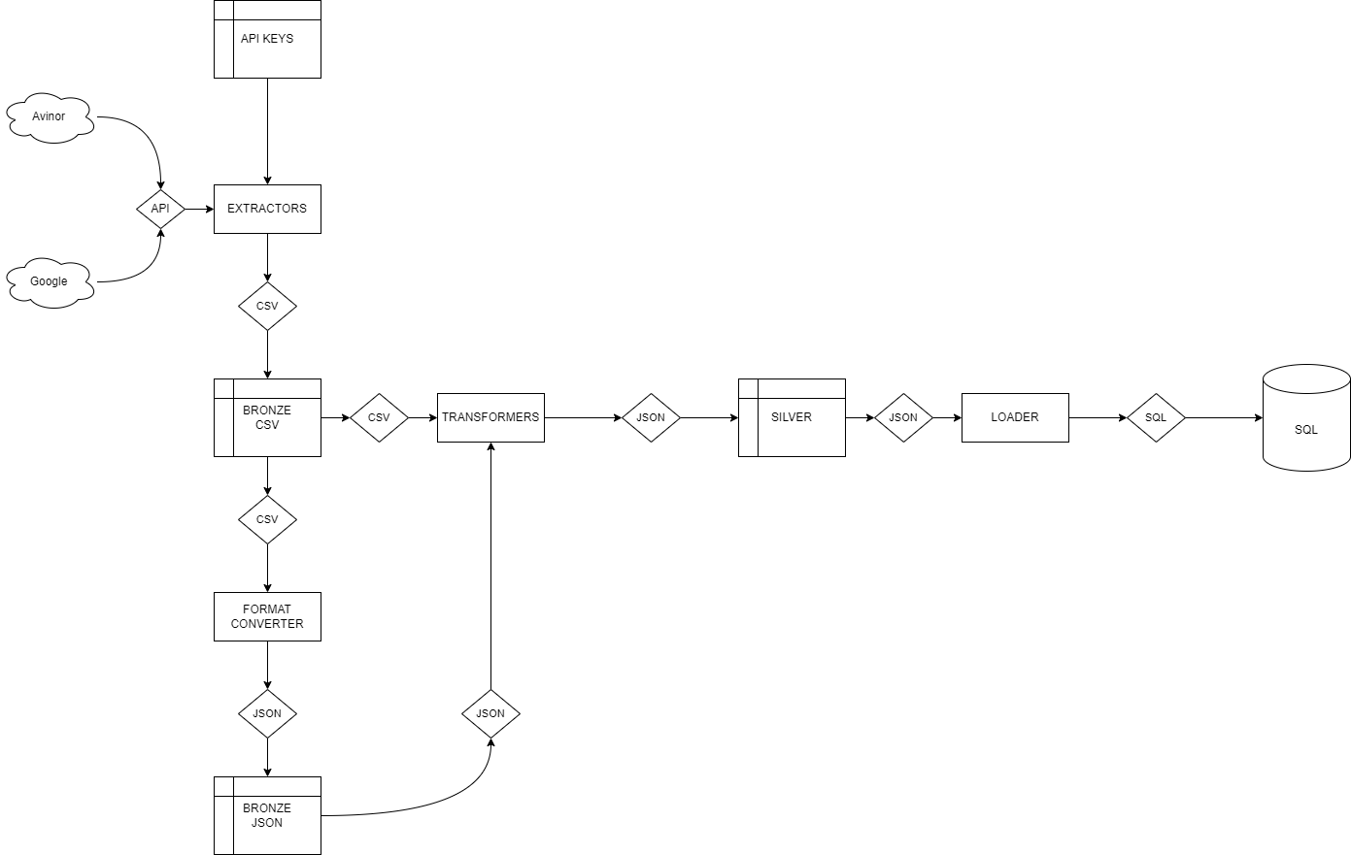

Slide 15
THE END PRODUCT
AVINOR TABLE
ALL RELEVANT FLIGHTS
DISTANCE EMISSION
PLANE MODELS
EMISSIONS
DISTANCE

